Slide 1


SOMERSET PURPOSE
Somerset Academy, Inc. promotes a transformational culture that maximizes student achievement and the development of accountable, global learners in a safe and enriching environment that fosters high-quality education.
S - Set high expectations
O - Objective
M - Meaningful curriculum
E - Effective
R - Resourceful and responsible life long learners
S - Scholars who achieve proficiency and beyond
E - Evaluate continuously and use data to drive curriculum
T - Teachers who are highly qualified

Slide 2

DO NOT. . .
“Hang out” in the stairwells or on the second floor during lunch.
Chew gum. DO NOT BRING GUM!
Go on the basketball court with a skateboard!
Use the elevator without approval from the office.
Leave campus if you are a Middle Schooler, Freshman or Sophomore (Except for DE students)
Allow an underclassmen in your vehicle without prior permission, or you will lose all privileges for the remainder of the school year.
Throw anything off the balcony.
Throw anything from the ground level to the 2nd floor.
Eat or carry food over the basketball court or turf field
Litter or leave garbage around at lunch
Hang out by the wavy wall side or behind the basketball court bleachers
Hang on or grab the basketball nets/rims
Playing “keep away” = a detention
Yoga pants/ leggings/ are not allowed. Not even during dress down days. Dress code violations earn detentions
You are not to go to the Deans’ office during class to argue a detention. You will be turned away.

Slide 3
Discipline
Discipline is applied with mutual respect in a firm, fair , reasonable and consistent manner.
Preventive Morning announcements, Teacher and School's Rules & Expectations
Supportive Warnings for students to get back on task. Email notification to parents
Corrective Weekly Monday Detentions, Monthly Saturday Detentions

Slide 4
Somerset College Prep Discipline Matrix
*Warnings* Do Not apply to all discipline. Teacher & Staff discretion
DETENTION
SATURDAY DETENTION
SUSPENSION including DISMISSAL
3:50 to 4:50pm
Classroom Disruption
Disruptive Conduct
Chewing Gum
Bus Violation
Disrespect for others
Disrespect for property
Littering during lunch
Electronic Confiscation
Public Display of Affection / P.D.A
Profane Obscene Abusive Language
Running in the Halls
Spray used in the Restrooms
Tardy to Class
Tardy to School ( 3 late arrivals non bus rider)
9:30 to 12:30pm
Horseplay
Missed Detention
Multiple Detentions
Disruptive Conduct
Bus Violation
Skipping = 2 Saturday Detentions, Referral & 9 week Behavior Probation Contract
Cheating = 3 Saturday Detentions, Referral & Behavior Probation Contract
Excessive Detentions / Unserved Detention
Theft
False or Misleading Info
Open Defiance of Authority
Vaping
Physical Altercation
Fighting or Attempting to Fight
Assault / Intimidation Threat of Student
Weapons
Other Major Misconduct

Slide 5
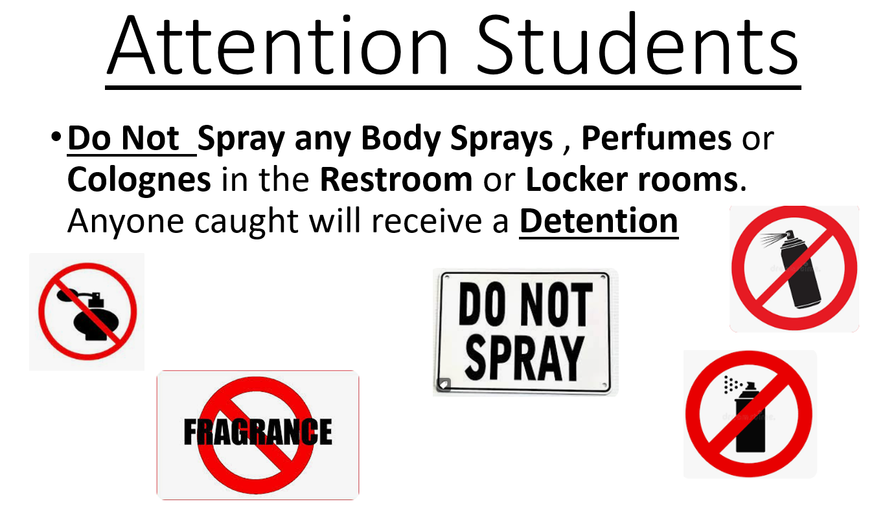

Slide 6

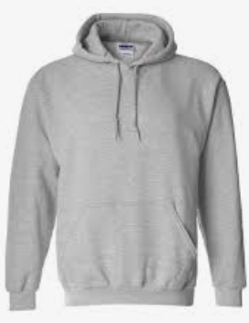
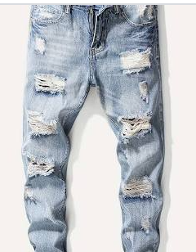
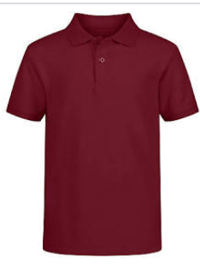
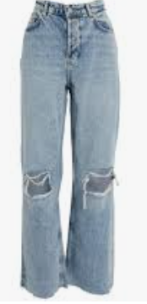
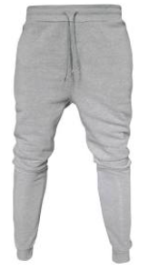


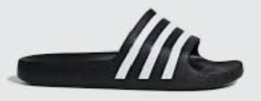

Dress Code Violations (Do Not Wear)
Ripped or Frayed Jeans
Non - Somerset, Hoodies or Polos
Crocs, Slides & Foam Runners
Sweatpants, Joggers, Yoga pants, tights or Pajama pants

Slide 7
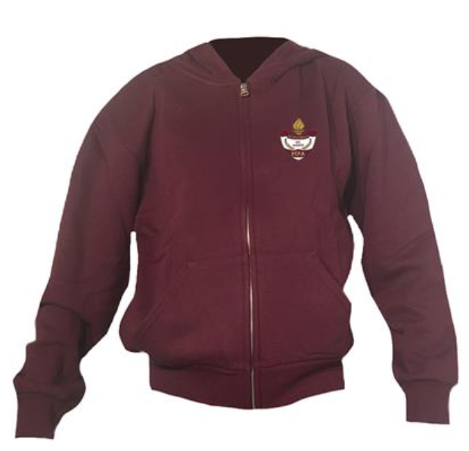
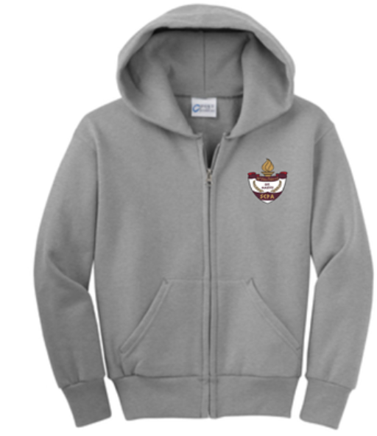
Dress Code Violations
A Somerset College Prep shirt must be worn underneath a zip up Hoodie or Jacket.
Exceptions would include
House Shirts on Thursday's
School Friday Shirts
Club Shirts
School Athletic apparel for game days.
Anyone not in compliance will be given a Dress Code Violation according to our Discipline Matrix.

Slide 8
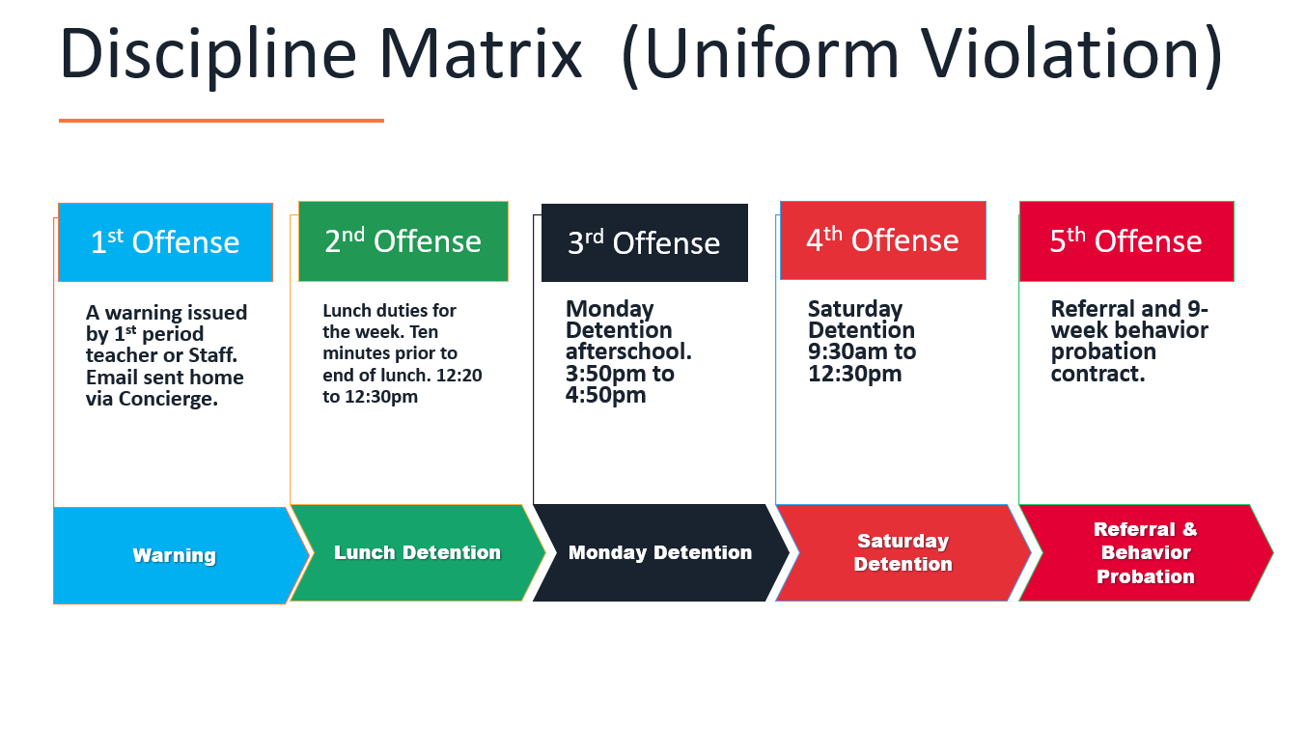

Slide 9
Dress Code (What can I wear)
School Appropriate Attire
OK
Solid Color Shorts (Fingertip length or longer)
Denim, Khaki, Cargo & Jean Shorts
House Shirts
Club Shirts
Skorts, Capris Any color
Not OK
Spandex Material
Rips , Tears or Frays
Sweatpants, Yoga pants
Tank tops
Leggings
Bottoms with print or derogatory slogans

Slide 10
Dress Code Violations
A Somerset College Prep Shirt must be worn underneath a zip up Hoodie or Jacket.
Shirts include
House Shirts
School Friday Shirts
Club Shirts
School Athletic apparel for game days.
Anyone not in compliance will be given a Dress Code Violation according to our Discipline Matrix.

Slide 11
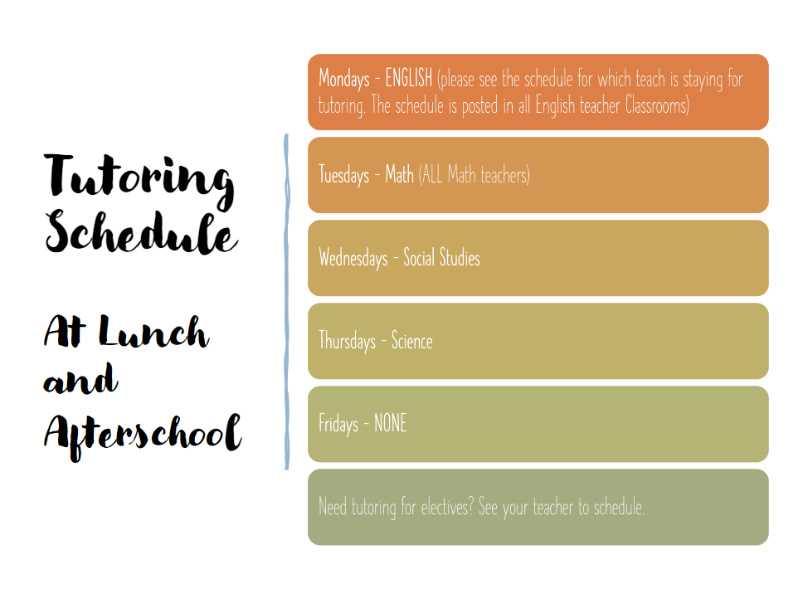

Slide 12

Tardy—being late to class.
Being tardy to periods 2, 3, or 4 is accompanied by a detention.
Period 2, 3, 4 teachers write & submit the detention.
Being tardy to 1st period is a detention if you are a bus rider and your bus was on time.
Being tardy to 1st period and you are not a bus rider is a detention for every 3rd occurrence.
*Does not apply to excused tardies.

Slide 13
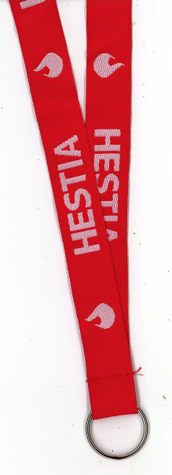
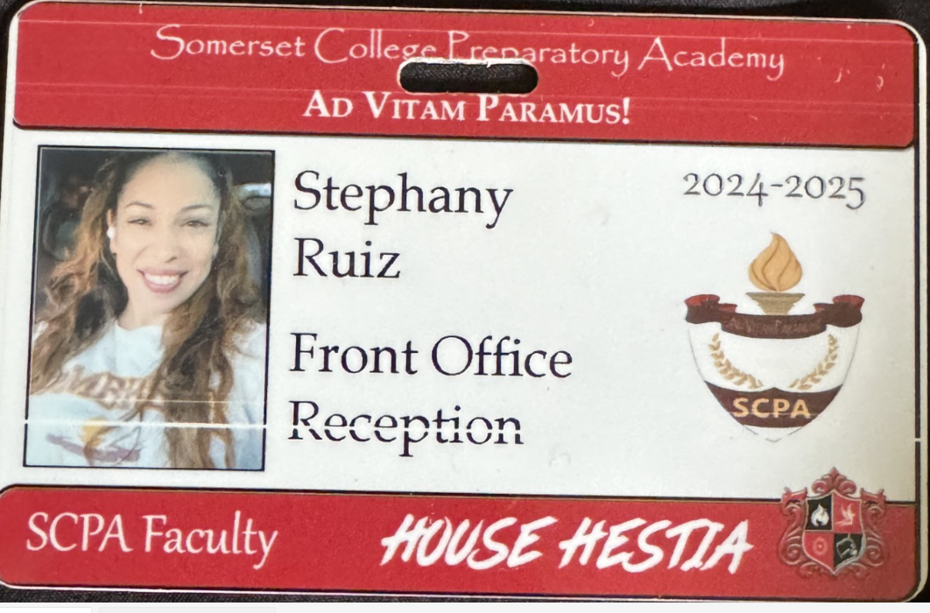
Lanyards and IDs are a Mandatory
Part of your uniform
Keep in your backpack
Needs to be worn everyday you’re at school
No Lanyard and ID will result in a dress code violation.

Slide 14





No Sports on Turf Afterschool without a Coach

Slide 15
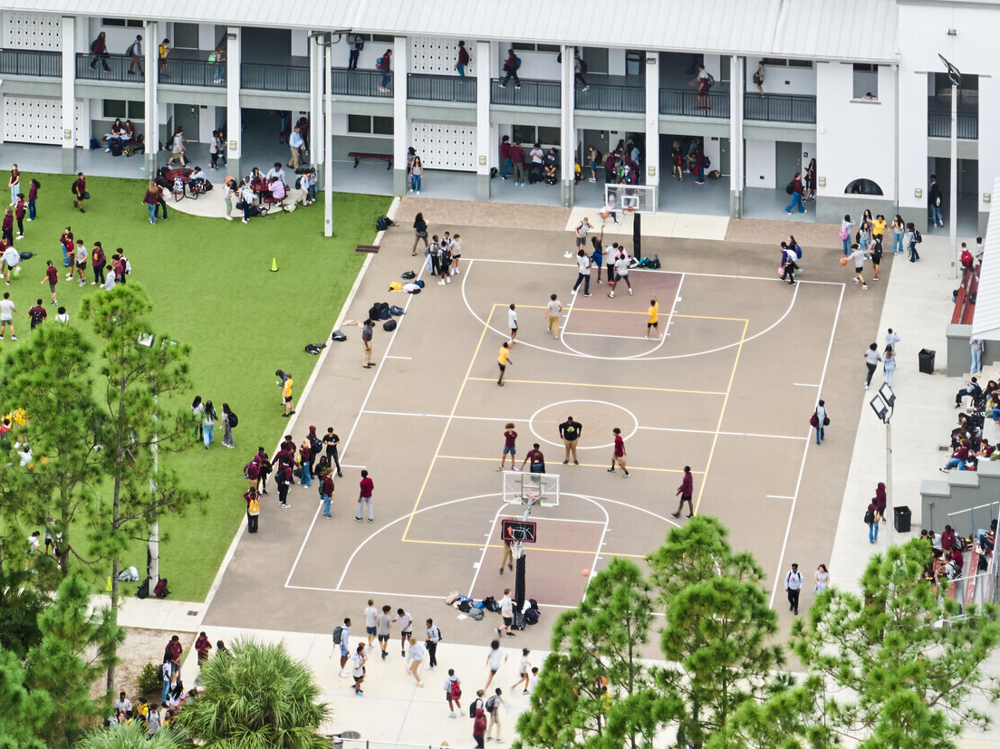
NO FOOD or drink ON THE COURT

Slide 16
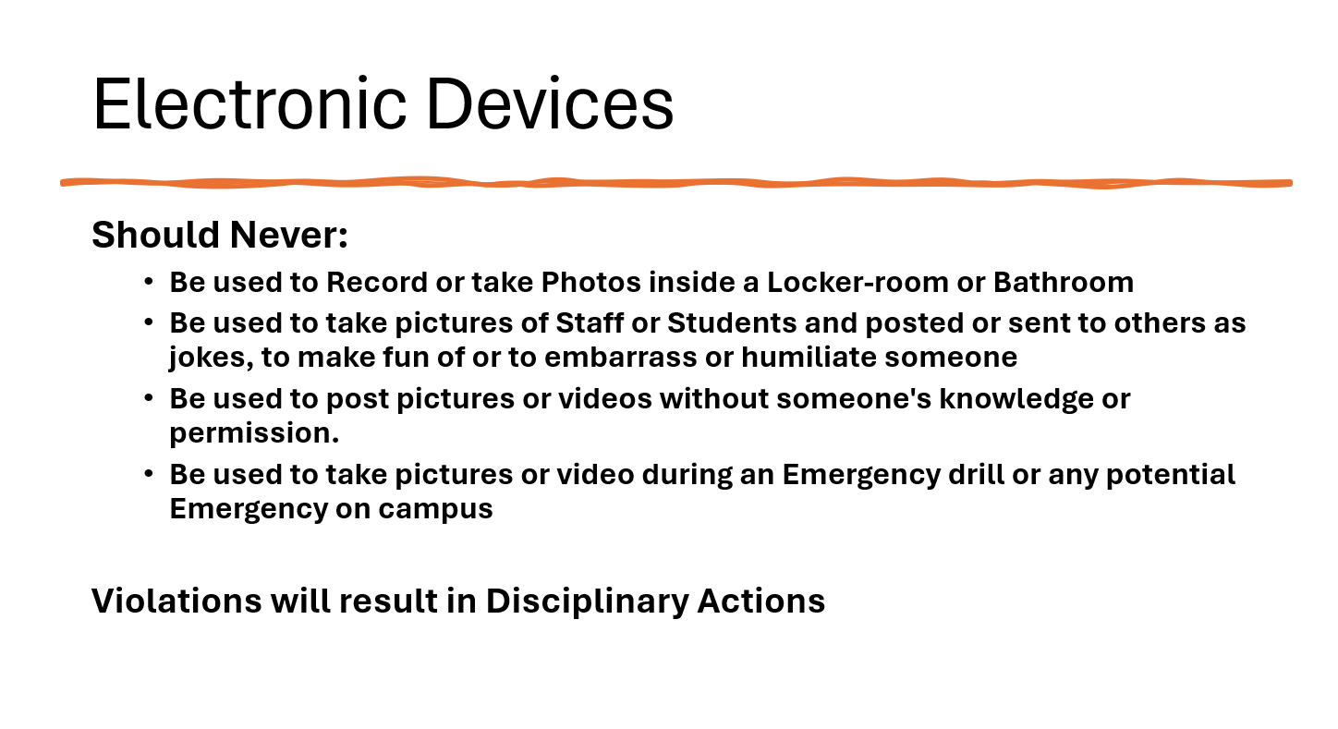

Slide 17
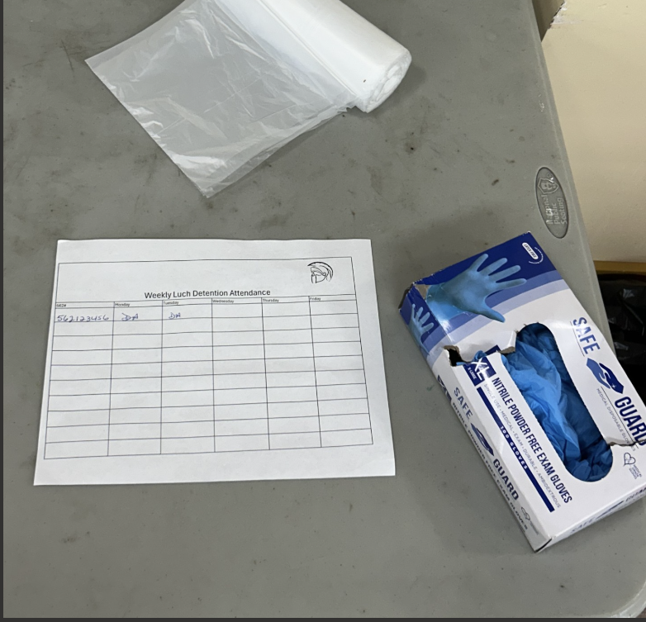


NEW Lunch Detention Procedure
Lunch detention will be the entire week Monday to Friday
Each day at 12:20 students need to report to the cafeteria
Initial the sign in sheet for the day
Retrieve 1 glove and 1 bag from table inside cafeteria
Assist with picking up trash and trays left behind by students around campus
Cameras will be reviewed to ensure Detention was served.

Slide 18
Student Parking
Only students with a parking permit may park on campus.
1st Violation: Warning
2nd Violation: Detention
3rd Violation: Revocation of Parking Permit
Non-Permitted Parking: TOWED at OWNERS EXPENSE

Slide 19
Upcoming Testing
Algebra/Geometry EOC—12/11
Biology EOC—12/12
US History/Civics EOC—12/13
Classroom Finals:
Periods 1/3: 12/16
Periods 2/4: 12/17

Slide 20

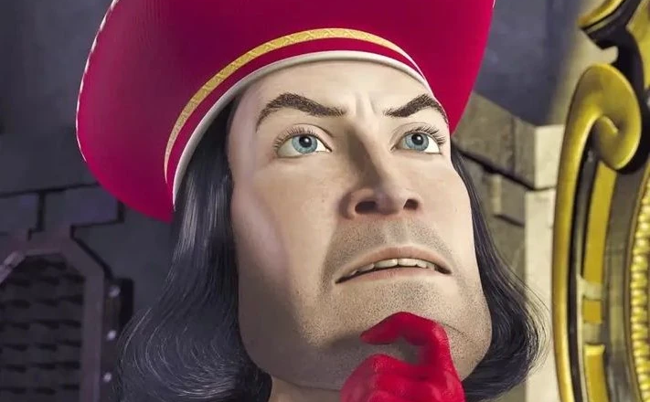
DRAMA CLUB MEETING(S)!!!!
Tuesday 12/10 @4 pm!
Thursday 12/12 @4 pm!!
Showtime: 12/18!!!
Learn those lines!!!!

Slide 21



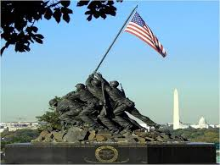
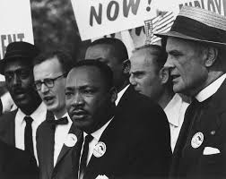

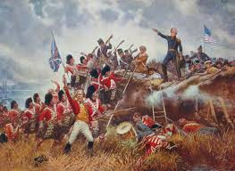
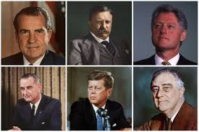
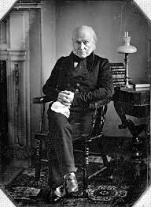
Kyryliw’s US History EOC Study Sessions
-Tuesday December 10th-Thursday, December 12th
Afterschool from 4:10-5:15

Slide 22
Last Call
Marsh EOC Civics Prep Today 4pm-5pm
Zoom Call Virtual Prep
Tonight 8-9pm

Slide 23


Slide 24
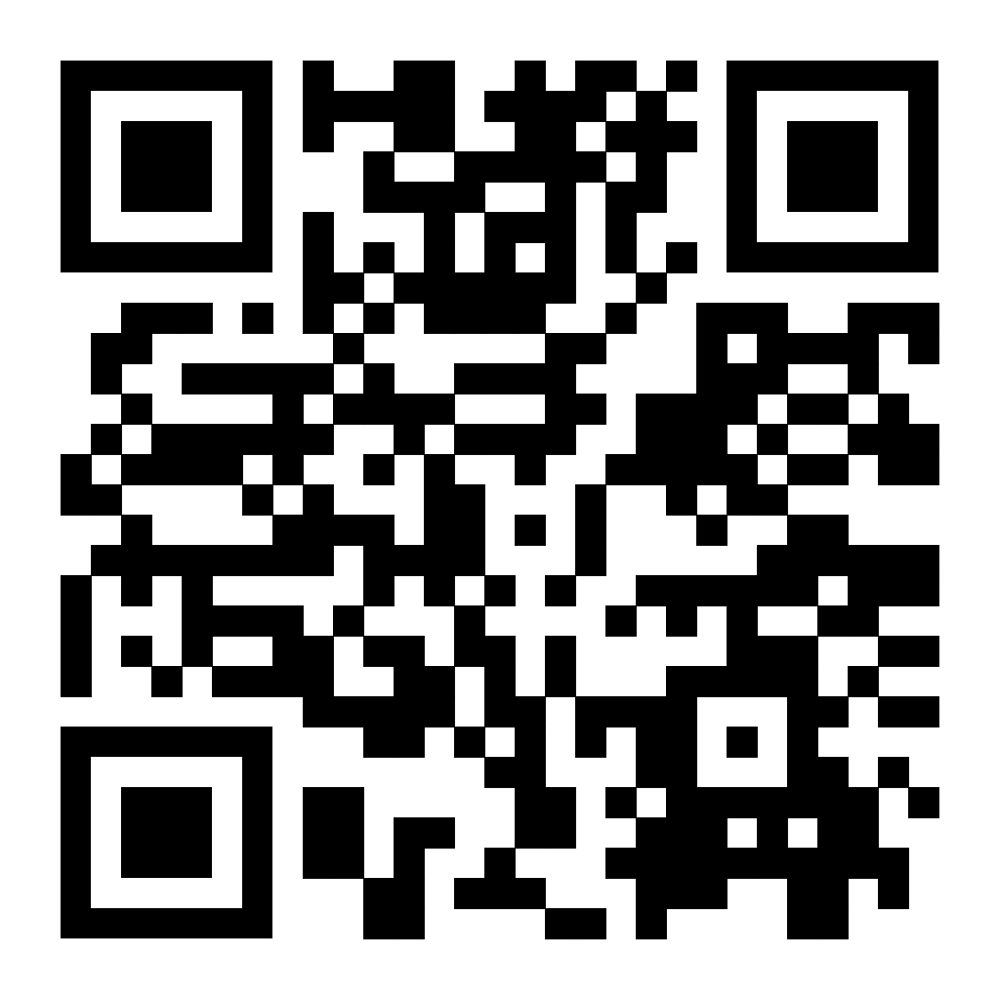
Teachers vs. Students Volleyball Game
If you are interested in playing, fill out the form!
IMPORTANT: If you are selected to play, you must buy your ticket by 12/13. You must show student ID. You will receive a special ticket.
December 20th After Lunch
Tickets: $3
All proceeds go to a foster home!
Roster for who is selected will be available 12/11
Tickets will be sold in the spill-out area during lunch
12/11 - 12/18

Slide 25


Slide 26


Slide 27
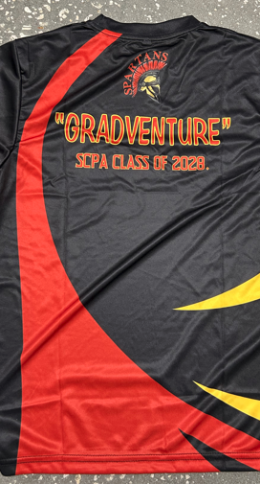
Free Gradventure Shirts
Class of 2028 ( 9th grade) ONLY
Interested!
Email Mr. Horne with your size.
(Use School email) Horne.David@somersetcollegeprep.org
All sizes available. All shirts must go.

Slide 28
Community Service Club
Next meeting will be Wednesday, December 11th in Mrs. Braia’s room (232)

Slide 29


!Attention!
Dungeons and Dragons Club INFO!
READY FOR ADVENTURE, THRILLS, AND FANTASY?
COME TO THE D&D CLUB MEETINGS
MONDAYS AT 3:50 TO 5:15 PM
IN ROOM 175

Slide 30
School Clubs
Chorus- Highschool: Afterschool 4-5:30 Mondays in 268C
Guitar Club- Mondays, afterschool from 4-5pm in 169C
D&D Club- Mondays, afterschool, in 175C, from 3:50-5:15
Movie Club- Mondays, at lunch in 234A
Boxing Club- Outside on the turf afterschool, on Mondays, Wednesdays, and Fridays
Florida Future Educators of America (FFEA)- Tuesdays at lunch in 164C
Artists for a Cause- Tuesdays at lunch in 268C and 2nd Wednesday of the month, afterschool in 268C
English as a 2nd Language Tutoring- Tuesdays, during lunch and afterschool, in 124A from 4-5pm
Community Service Club- Wednesdays at lunch in 232A
Student Government Association (SGA) - Wednesdays, Afterschool in 226A
Chess Club- Thursdays at lunch in 234A
Chorus- Middle School: Afterschool 4-5:30 Thursdays in 265C
Spartans Against Destructive Decisions (S.A.D.D) – Thursdays at lunch in 129A
Science Olympiad- Fridays at lunch in 247B
First Priority- Friday, at lunch, in 263C
GSA- Fridays, at lunch, in 169C

Slide 31

Interested in starting a school club?
If you’re interested in starting a school club, you should do the following:
  Find a teacher to sponsor the club. Give them the details about the club so they know if they’re able to sponsor the club.
  Create a petition and get students who would be interested in your club to sign it. This shows that your club has generated interest.
  Talk to someone in administration about getting your club approved. Tell them who the sponsor is, when the club will occur (lunch or afterschool), and what the club entails.
  Email Mr. Kyryliw (Kyryliw.Michael@somersetcollegeprep.org) the information about you club and a slide advertising it. I will leave the advertising slide up for a week or so and create a slide listing all the club information for easy reference.

Slide 32
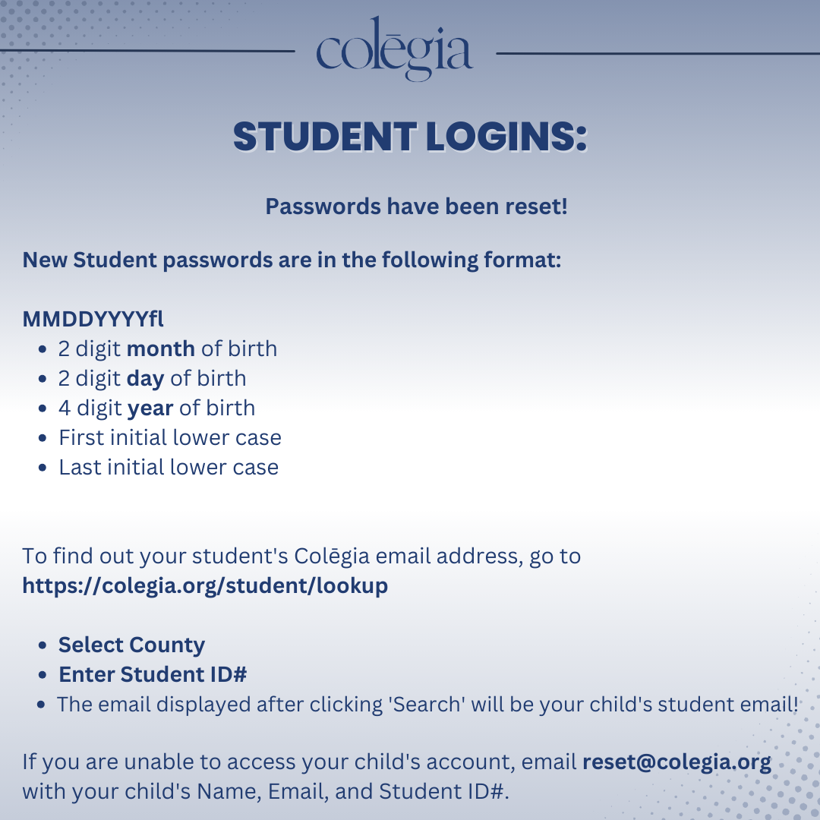

Slide 33


Somerset College Prep &Public Wireless ACP Program
This document will also be in the front office for you to scan the QR code.

